Slide 1


Project plan: PasarWarga
Hendra Wijaya (A20529195)

Slide 2

Introduction
PasarWarga is a personal experience during my short stint in the industry back in my home country. In the Indonesian native language, "pasar warga" ubiquitously means "people's market". I was employed as a member of the internal software engineering team.

Slide 3
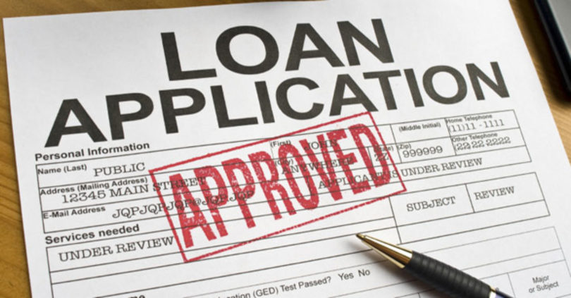

Scope
Product affordability: As the name suggests, PasarWarga is an electronics marketplace for inexpensive listings.
Purchase installments: Integrate transaction gateway with down payment options to support shoppers with limited funds.
Multi-platform: Seamless shopping experience with website and mobile applications.

Slide 4

Limitations
PasarWarga sells goods on behalf of individuals or organizations that own them. However, unlike Amazon and its warehouse, it does not have a physical location to keep customer's items even though it maintains inventory and shipment proceedings.
There is no way to change the Indonesian language and currency since PasarWarga has no plans to expand internationally.

Slide 5

Methodology: Agile
Agile methodology prevails because it is a new business with an evolving vision.

Slide 6











Tech stack
Web engine powered by Laravel written in PHP. The framework has a built-in database and caching support.
Native Android application composed of Java and Kotlin code.
Also utilizes local services:
Payment: Doku, Kredivo
Shipment: JNE, JNT

Slide 7
Test plan
Unit testing
Acceptance testing
Load testing
Authentication: User registration and login sessions.
Exploration: Search product catalog and prioritize high-engagement listings.
Transaction: Check inventory availability and multiple shipping methods.
Internal: Early drafts are passed internally for constructive discussion and further refinements.
External: Present a working concept to higher management end users.
Security: Assess common vulnerabilities to protect consumer data.

Slide 8
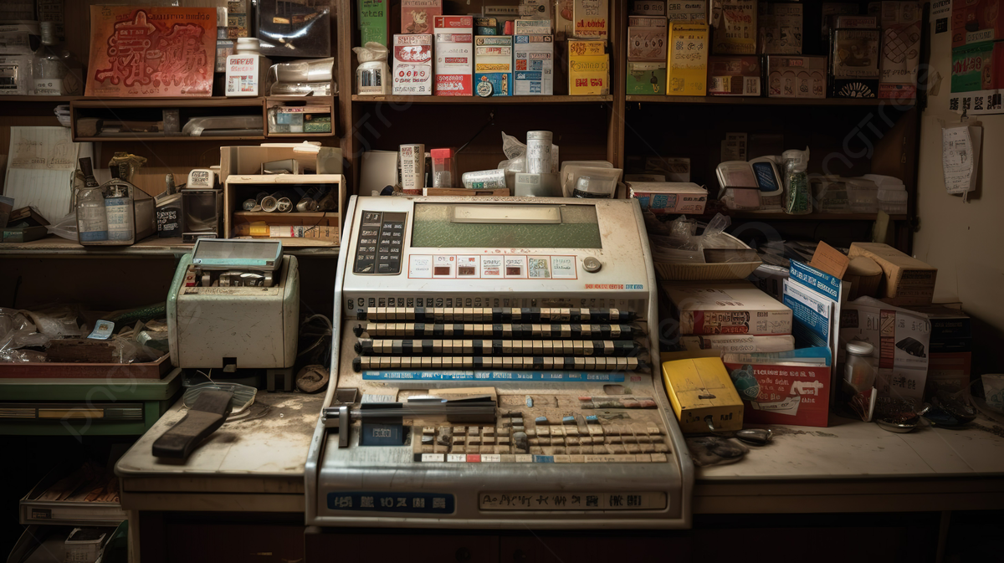
Resources
Desired financial objectives, budget estimation and project deadline.

Slide 9
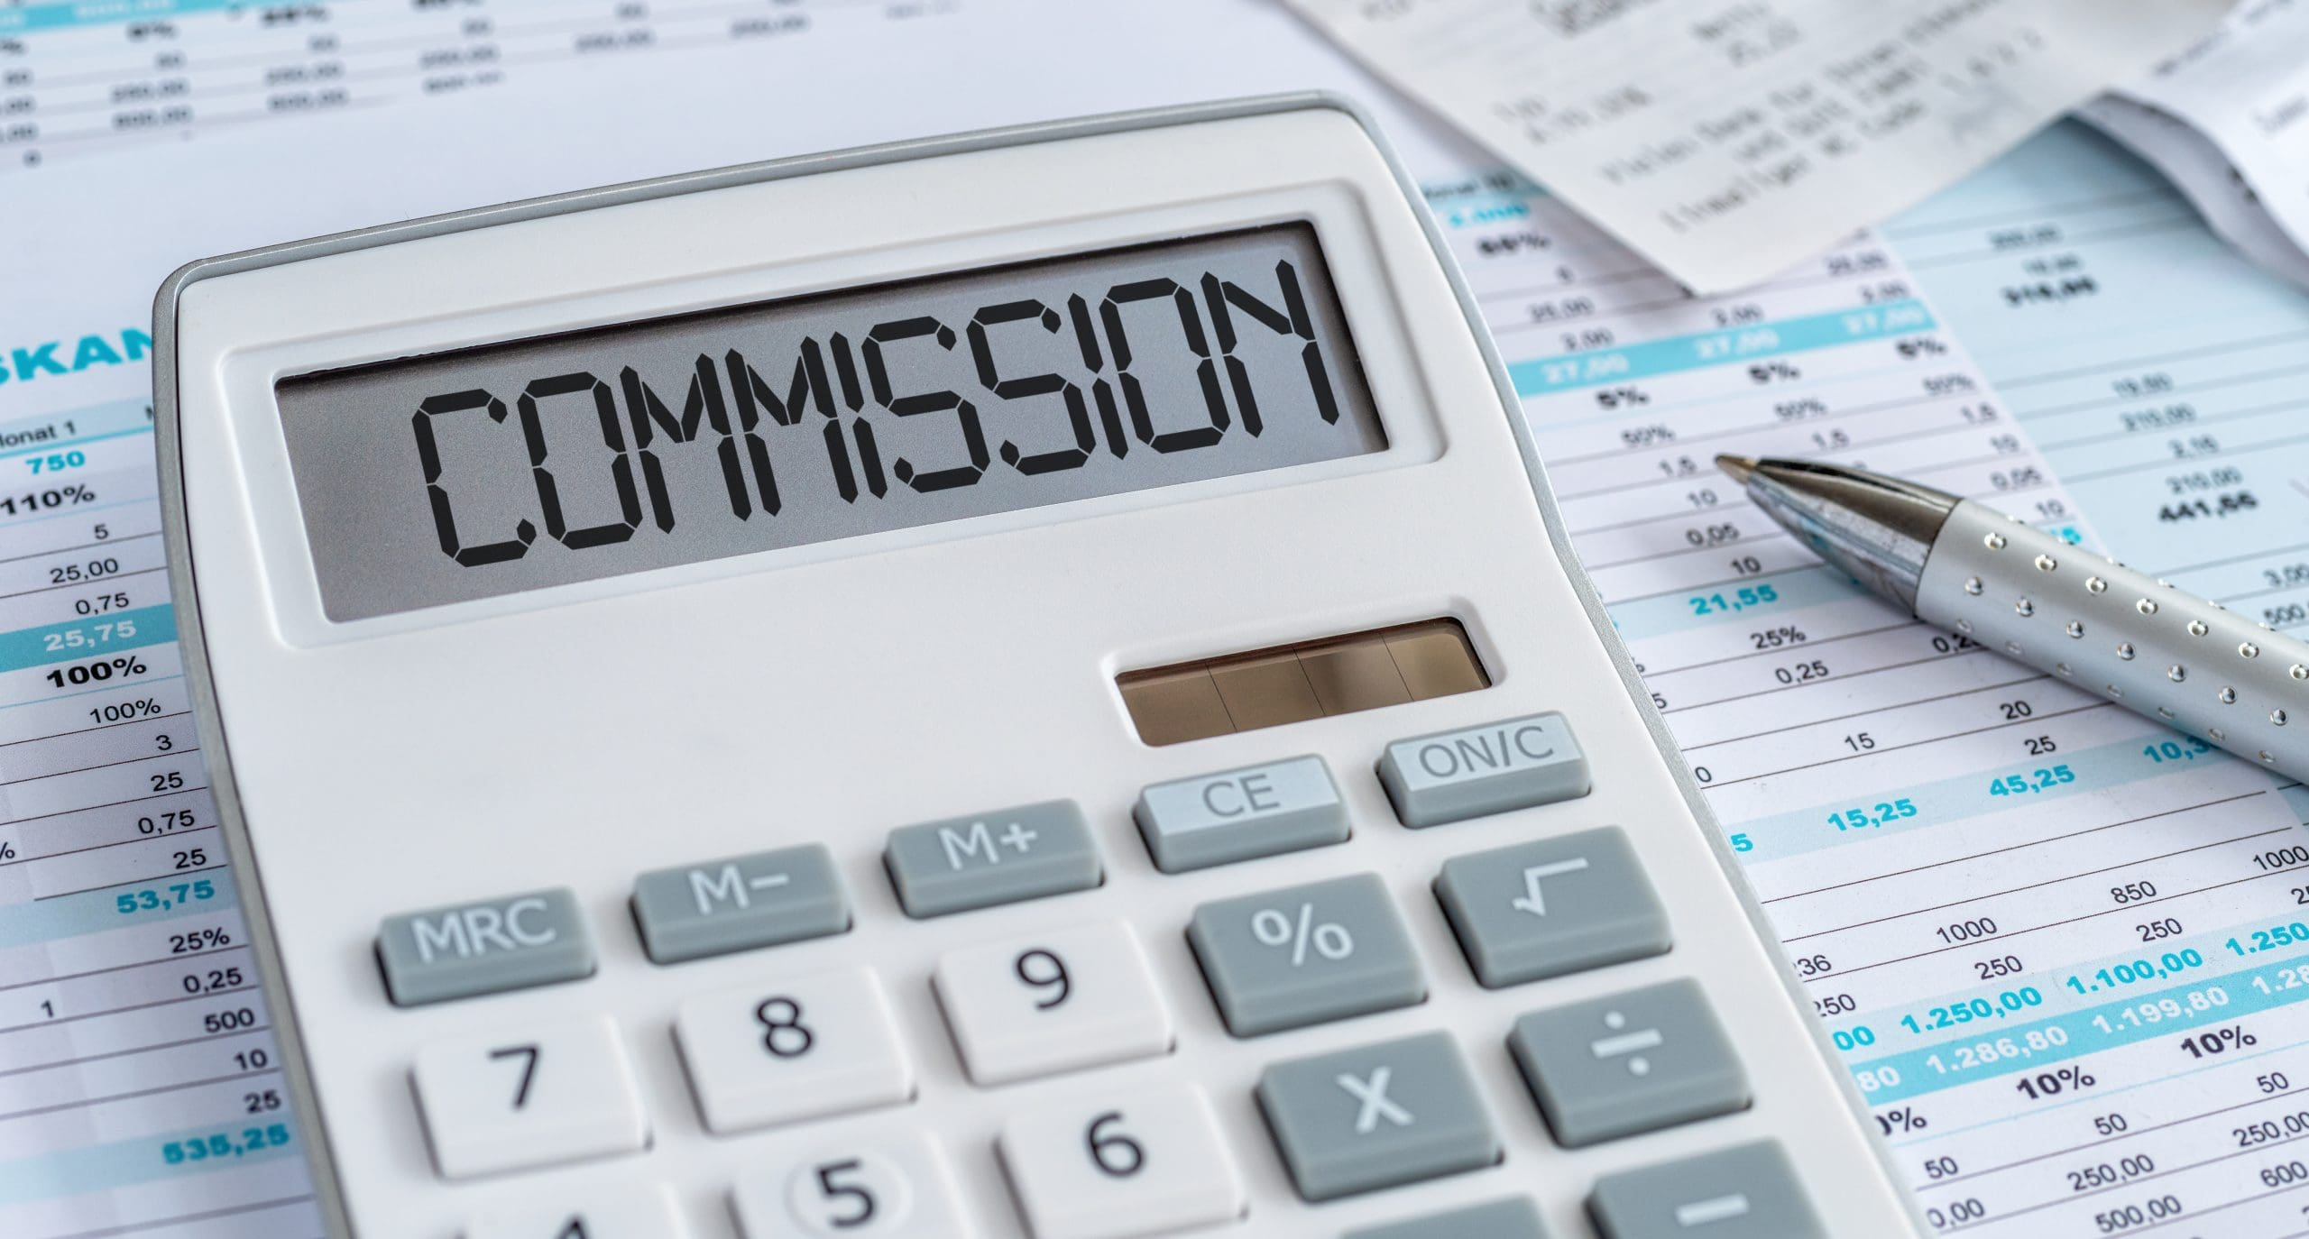
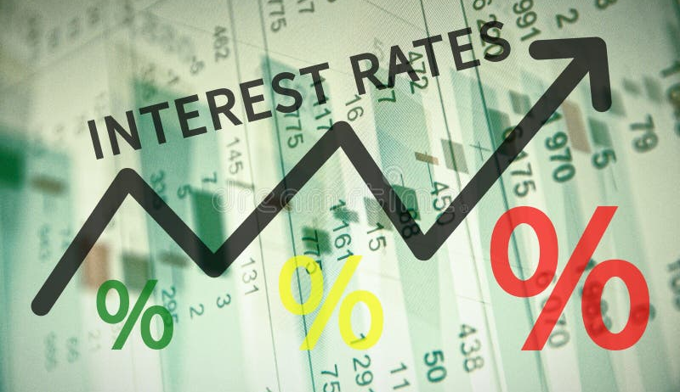
Revenue
Earning source: Tax a reasonable commission for every confirmed sale.
Secondary revenue: Diversify income with in-house loan options.
* Although it is commercial work, I can't state projected revenue as I was not involved in business meetings.

Slide 10
Cost
• Estimated pricing & converted into USD. | Development |  | Business
Moderate front-end & back-end team | $100.000 | Business analysis | $20.000
Small mobile team | $50.000 | Vendor meetings | $10.000
Proprietary services | $30.000 | Advertisement | $25.000
Hardware & networking | $20.000 | Unintended fees | $5.000
Total | $200.000 | Total | $60.000

Slide 11
Time

Slide 12
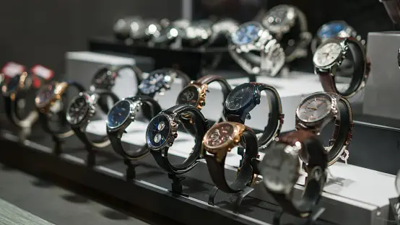
Evaluation
Guidelines to enforce product quality and assess incoming risks.

Slide 13
Quality control
Monitoring
Feedback
Management tools: Arrange tasks using synchronized software such as Atlassian Jira and JetBrains YouTrack.
Frequent events: Encourage tracked online conversations but conduct meetings to report anomalies and raise emotional spirit.
Documentation: Create a centralized knowledge base to avoid repeated efforts.
Unbias inspection: Incite input from end users through surveys and focus group meetings.
User story: Measure achievements from the perspective of end users.

Slide 14
Negative risks
Major change: Drastic adjustment to requirements during execution will prolong the schedule.
Response: Escalated; Voice the concern to board members with decision-making power.
Score: 4 (high impact) × 3 (likely) = 12 (moderate)
Third-party disruption: The project integrates with many external services with varying uptime.
Response: Mitigated; Implement an error-handling mechanism to mitigate disturbance.
Score: 2 (less impact) × 4 (likely) = 8 (low to moderate)

Slide 15
Positive risks
Accelerated experimentation: Discover new functionality with agile methodology and high user engagement.
Response: Enhance; Evaluate whether the necessary work is up to par with difficulties.
Score: 3 (impactful) × 2 (less likely) = 6 (low)
Brand loyalty: Consumers in developing countries such as Indonesia are presumably attracted to affordability.
Response: Exploit; Maximize awareness with marketing and advertising efforts.
Score: 5 (extremely impactful) × 3 (likely) = 15 (moderate to high)

Slide 16
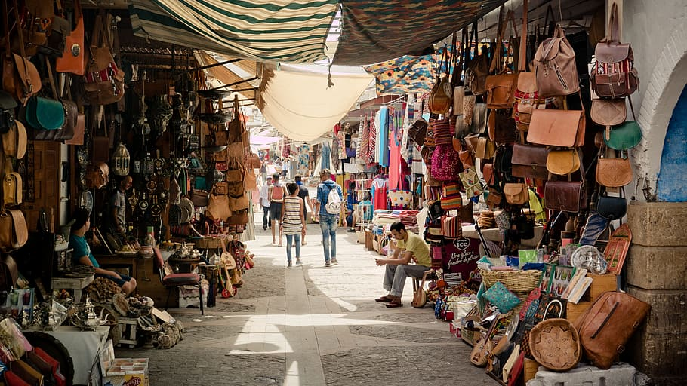
Conclusion
Report summary and current project status.

Slide 17
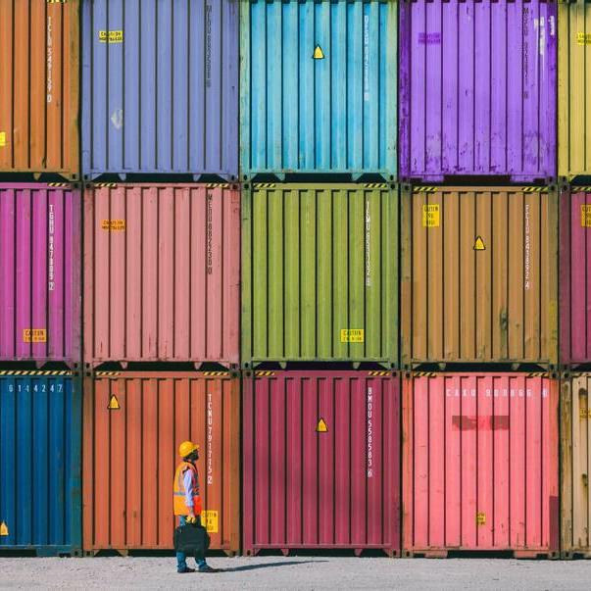
Summary
PasarWarga is on a mission to make e-commerce more accessible with value-based pricing. We emphasize down payment ability because this was not a common feature in e-commerce back then. As a new startup, the success of this project hinges on the accuracy of calculated risks and brand awareness.

Slide 18
Project status
Q4 2018
A sole project sponsor originally formed the idea. Iterate concepts and find suitable team members.
Q1-Q2 2019
Gather user requirements, visualize design prototypes and organize documentation. The first working concept of the website has been deployed.
Q3-Q4 2019
Begin the coordinated rapid development and testing. The project has experienced several months of delay due to minor UI/UX changes.
2020
Register the e-commerce business to comply with regional laws. Deploy the website and publish the signed mobile application.
2021
Enter a maintenance state where stability is prioritized over emerging features. Team members are relinquished to other projects within the organization.

Slide 19

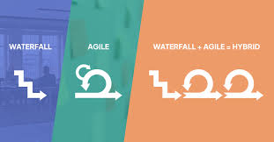
Second look
Popular standards: JavaScript has emerged as the most popular modern programming language. Switching to new technology will prevent entrapment into legacy code.
Hybrid methodology: The project could mix iterative agile development with a waterfall model. It should improve reliability by phasing new features systematically.
v

Slide 20


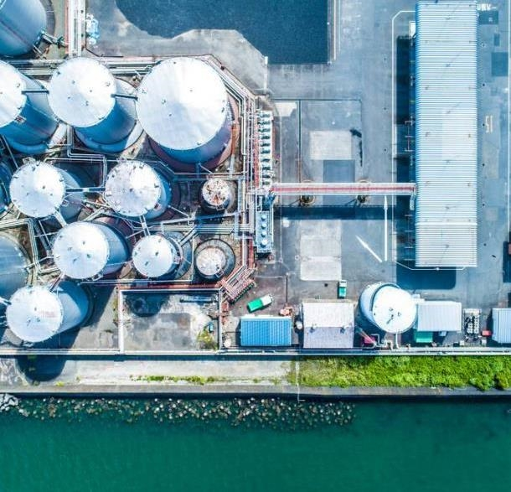
Thank you for your time.
Hendra Wijaya
A20529195
hwijaya@hawk.iit.edu

